Slide 1

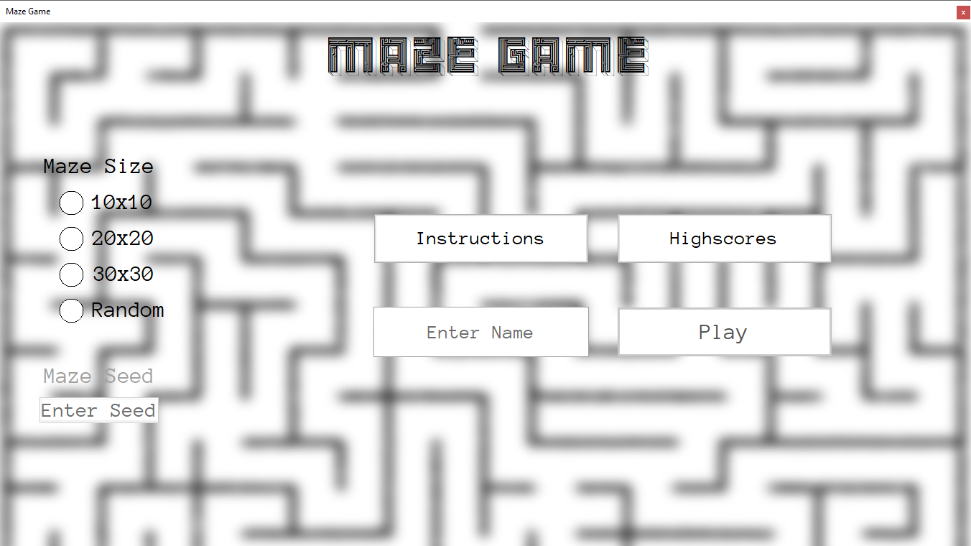
Welcome to the Maze Game. Let’s get started!
First of all, we need to enter a name. Click the ‘Enter Name’ textbox above!

Slide 2
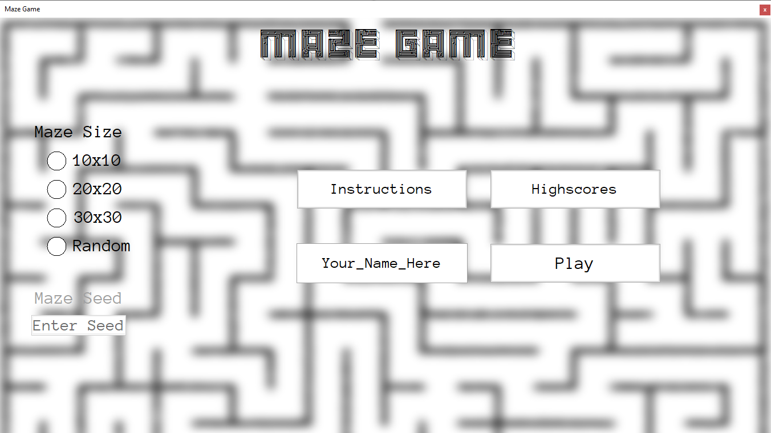
Now, let’s select a difficulty. It’s your first time playing so 10x10 is a good idea.

Slide 3
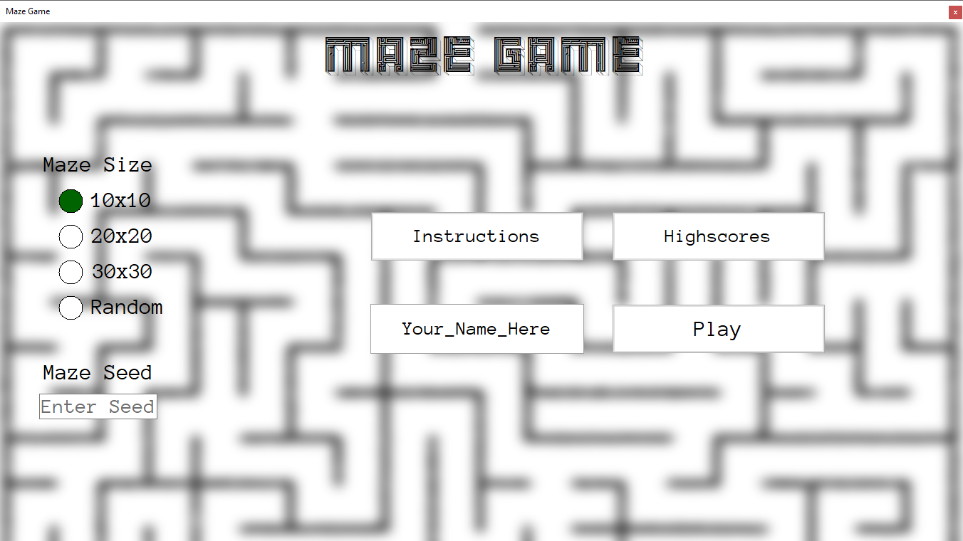
We can enter a maze seed if we wish to. In this case, we’ll enter the seed ‘CAFE’ (which is a valid hexadecimal number).

Slide 4
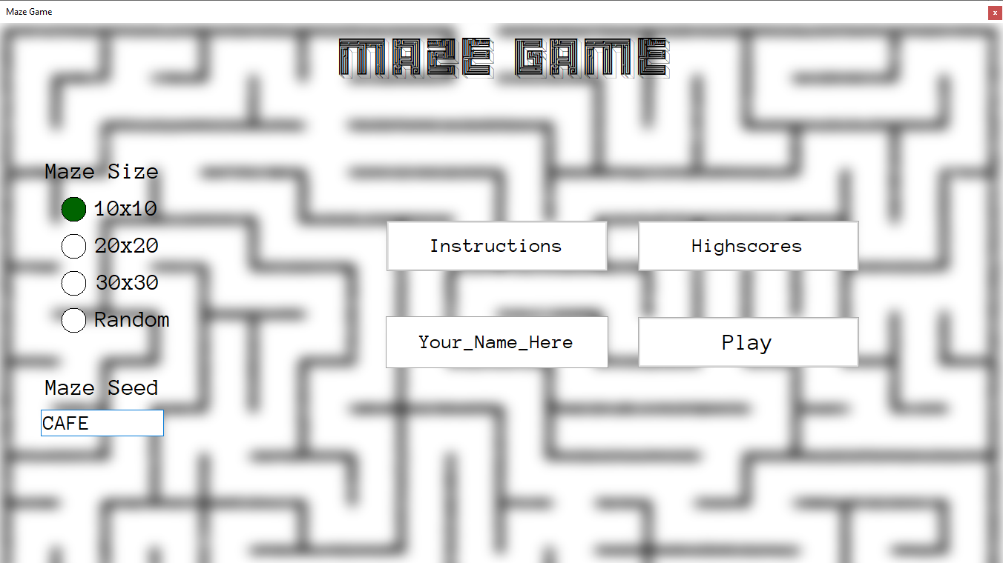
Now we’re all set to begin playing the game – so let’s go!

Slide 5
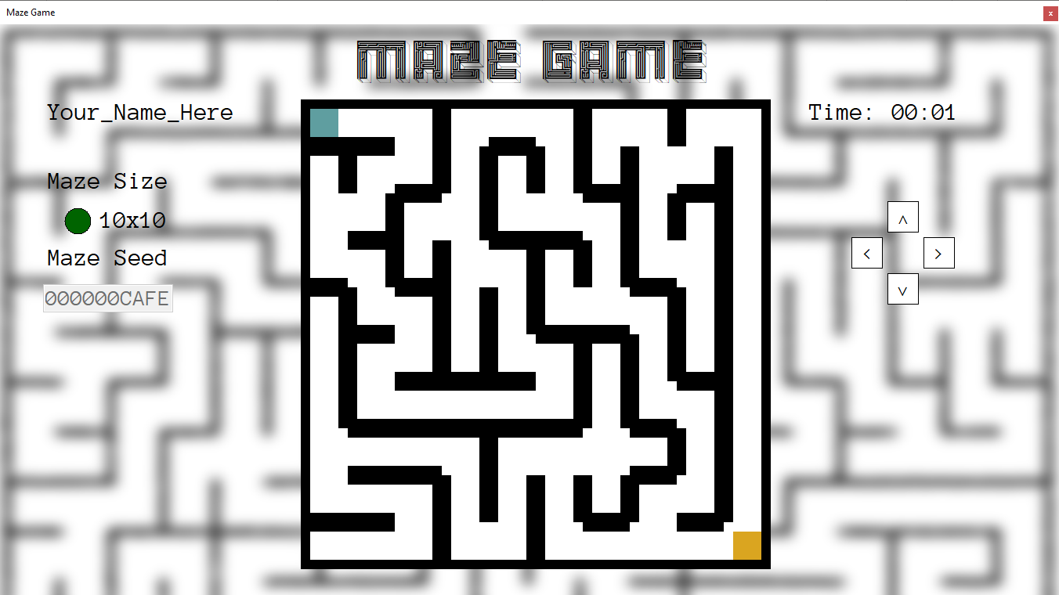
We start up here…
On this side is the timer and the gamepad, which we can use to control our player.
Let’s move to the right to begin moving through the maze.
All the information we have entered is on this side of the game screen.
And want to get here…

Slide 6
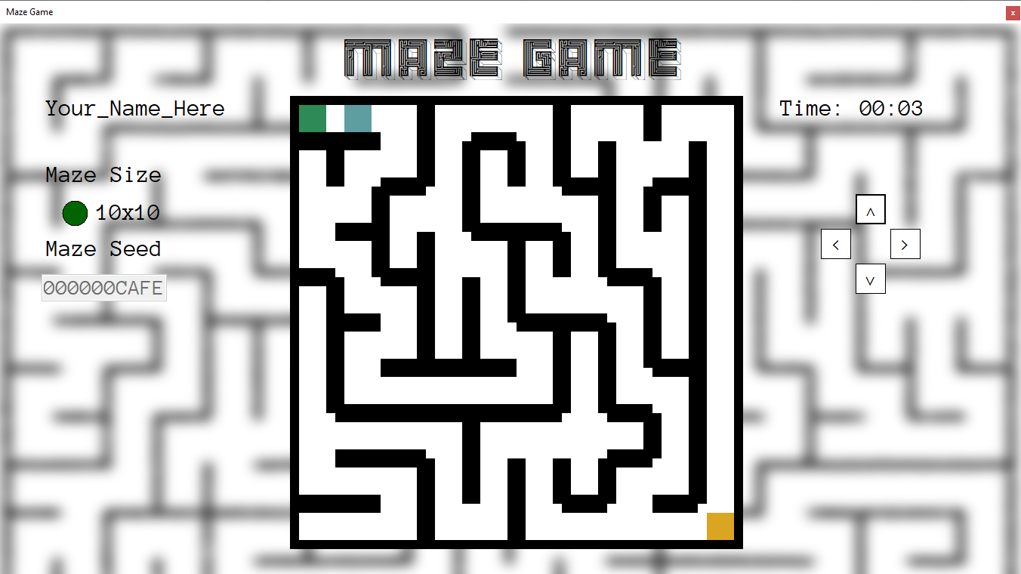
Hooray! We’ve moved one cell to the right. Let’s move one more.

Slide 7
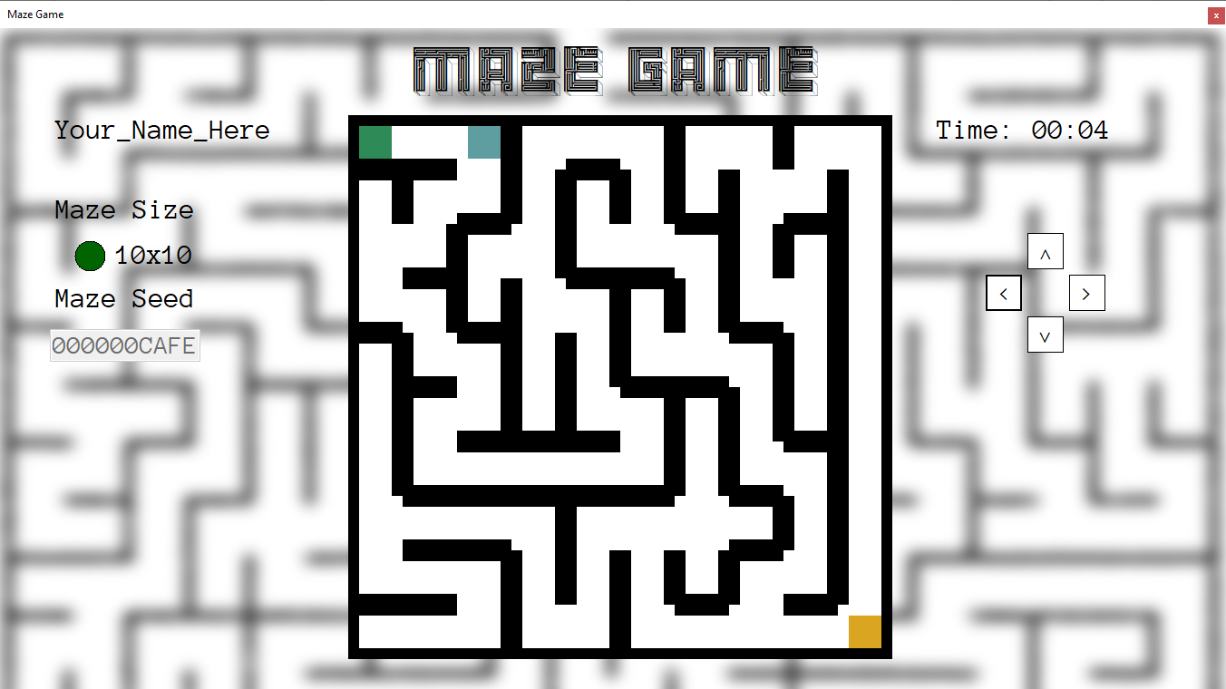
We now need to move down one cell.

